Slide 1

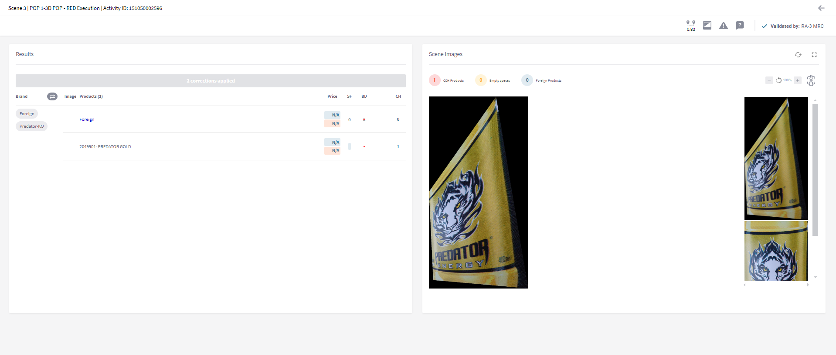
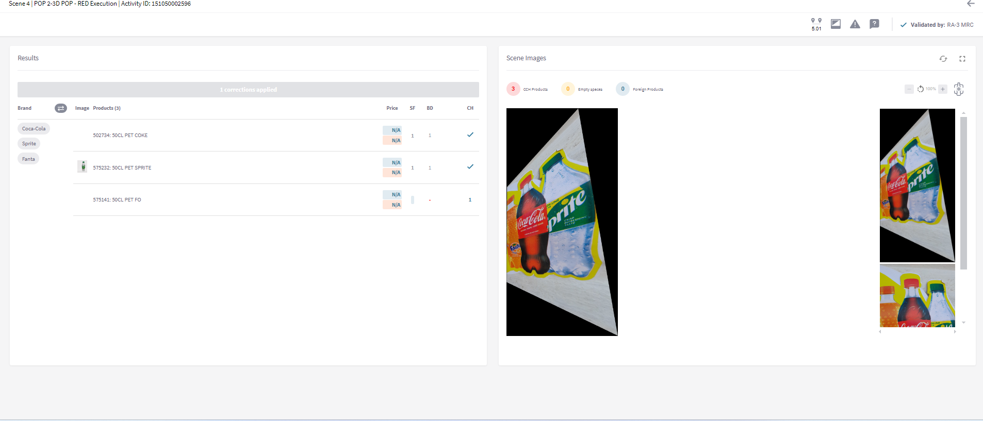
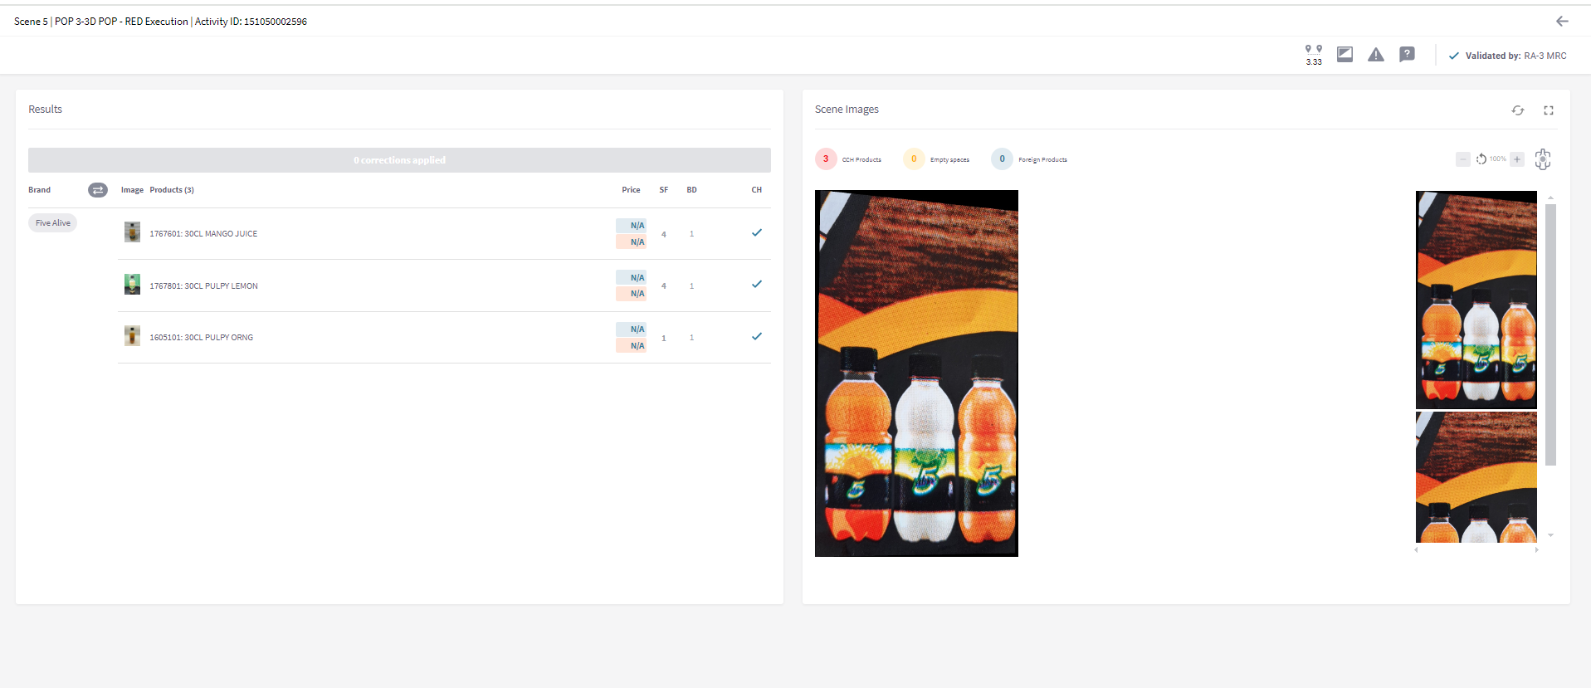
DEBORAH ABOLAJI USE OF 2D POP AS 3D POP IS AGAINST RED
BABATUNDE ADELEYE’S REPEATED PICTURE IN DIFFERENT OUTLETS
Outlet Number: 9405026422 SR Name: DEBORAH ABOLAJI
Outlet Name: FOLORUNSHO STORE
Date of Audit: 1st July 2024, CT: ILORIN West
Outlet Number: 9405026422 SR Name: DEBORAH ABOLAJI
Outlet Name: FOLORUNSHO STORE
Date of Audit: 1st July 2024, CT: ILORIN West
Outlet Number: 9405026422 SR Name: DEBORAH ABOLAJI
Outlet Name: FOLORUNSHO STORE
Date of Audit: 1st July 2024, CT: ILORIN West
Note: THE SR USE 2D POP AS 3D POP, HENCE WAS REJECTED, AS THE USE OF 2D POP AS 3D POP IS AGAINST RED GOVERNANCE POLICY

